Slide 1

Finding the Best Place to Invest In Real Estate Home Value vs Rental Price
JULIE HONG
CHRIS JONCHA
CHRIS LANG
BEN MELVIN
JUSTIN RATLIFF

Slide 2

INTRO
GOAL: To determine where in the U.S offered the best returns on rental properties
Challenges
Finding open source quality data at different levels of geographic areas (by State, City, Zip Code)
We chose this topic because we all have an interest in real estate and determined we could use our newfound data skills to enlighten ourselves on the topic
Data sources
Zillow data csv
Realtor.com csv
World Population Review.com csv
Realty Mole Property API
Finding data using API

Slide 3
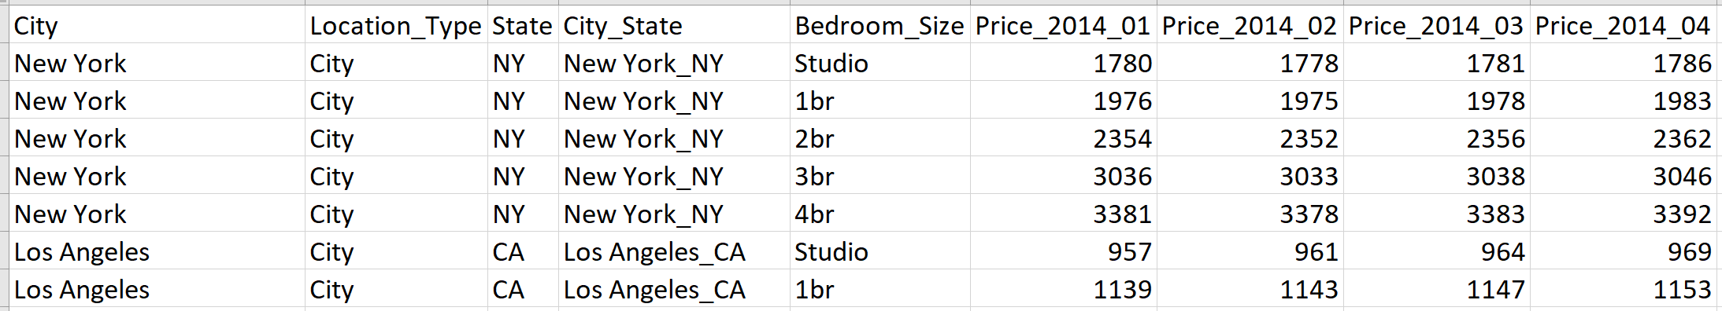
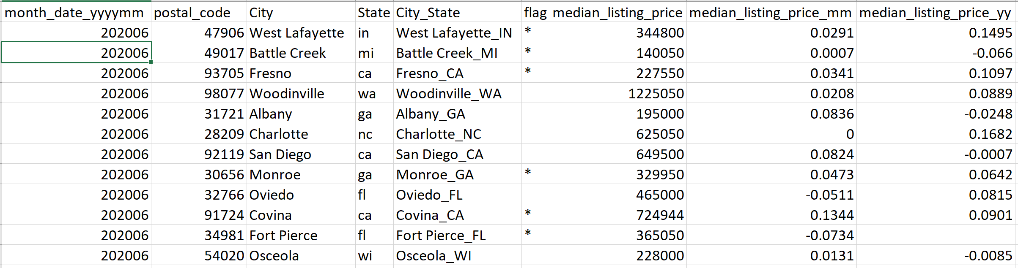
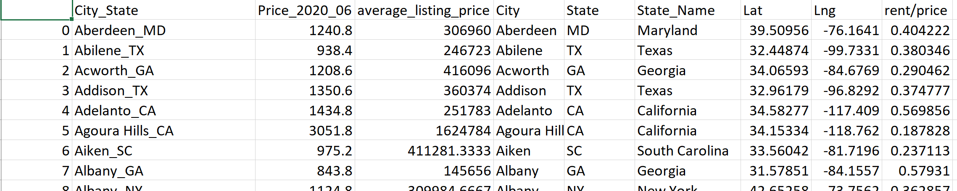
Data Merging Example
Rent CSV
Bedrooms averaged
Listing Sale Price CSV
Zip codes in each city averaged
Merged listing price and rent
Added Lat Lng for mapping
Merge

Slide 4
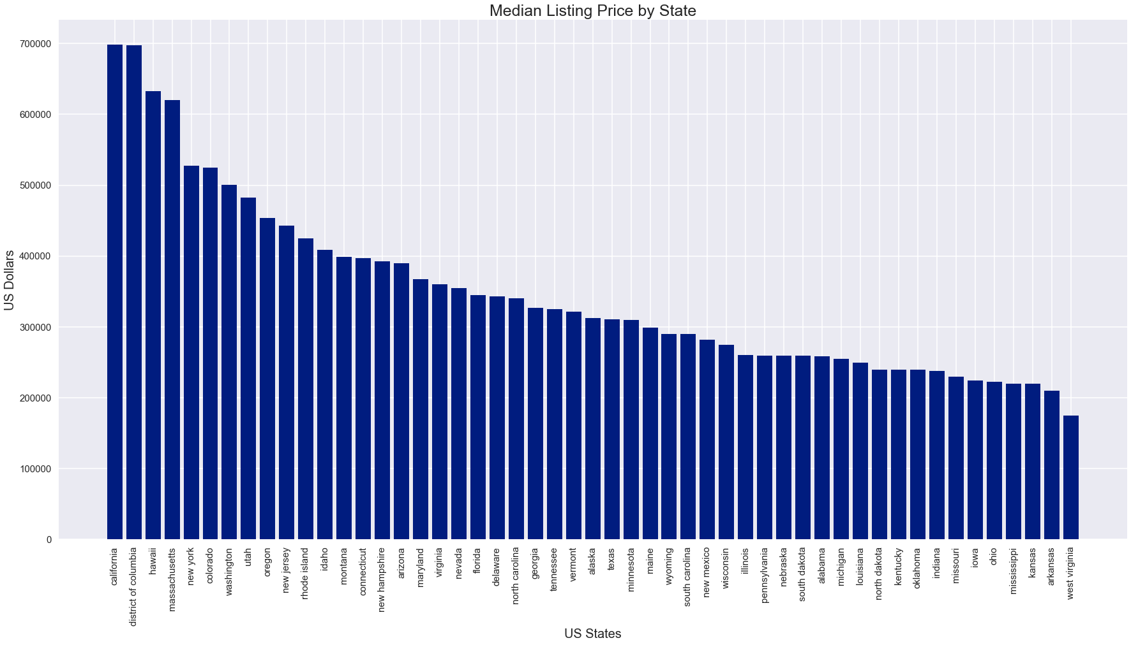
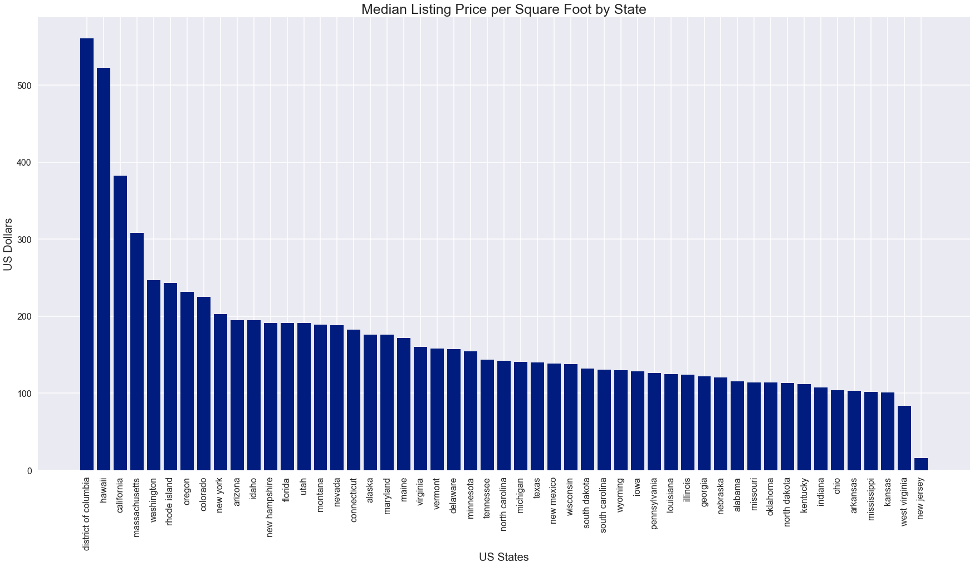
Home Cost by State
Median Home cost by state
Median Home price per Square Foot by state

Slide 5
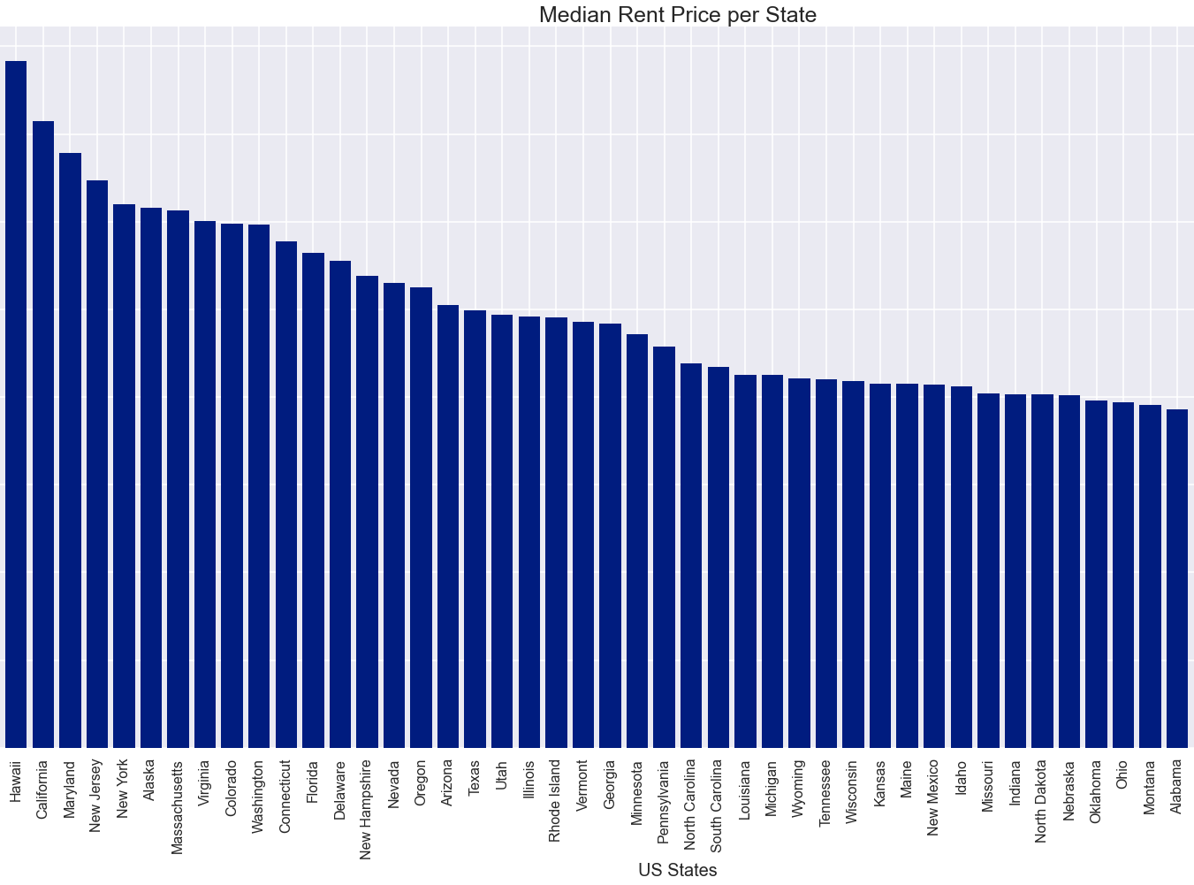
Median Rental Price by State

Slide 6
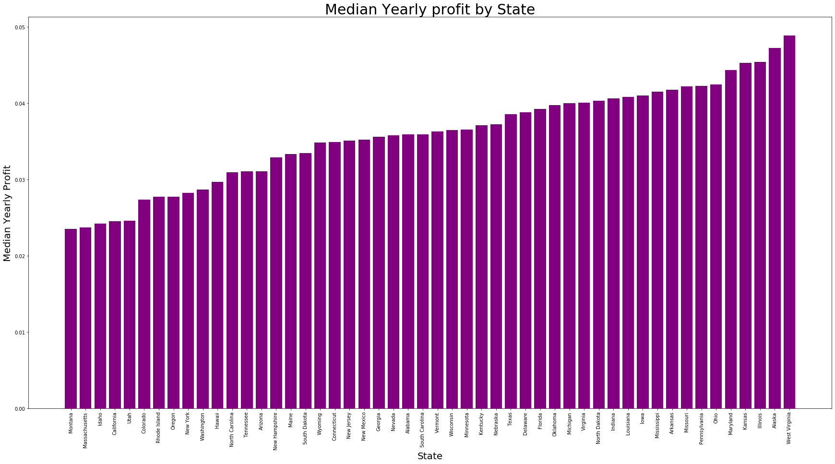
Home Cost Vs Rental Price by State

Slide 7
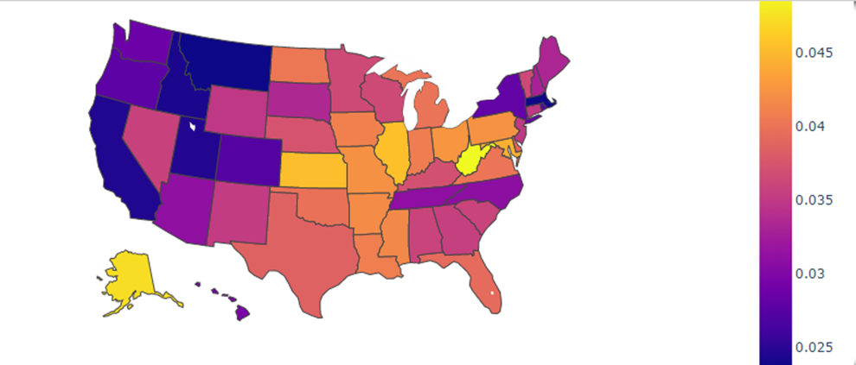
Heat Map of Home Cost Vs Rental Price

Slide 8
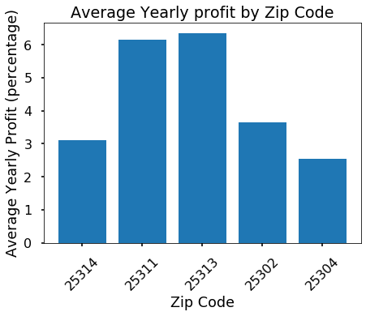
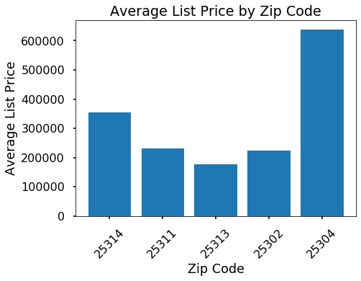
Profit By Zip Code for Charleston, WV

Slide 9
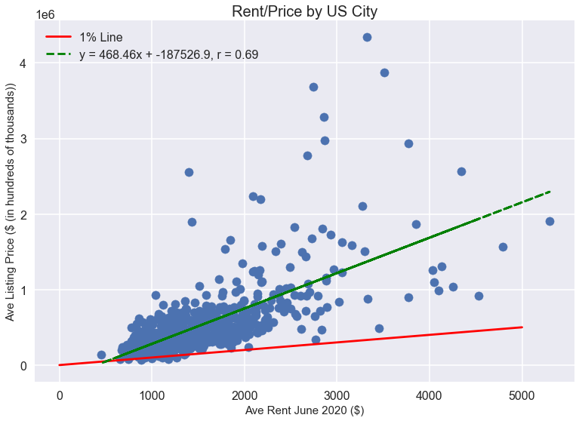
Home Cost Vs Rent Price at City Level

Slide 10
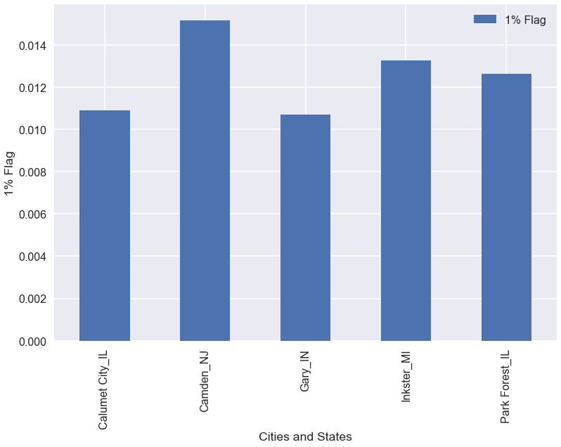
Top 5 Cities

Slide 11
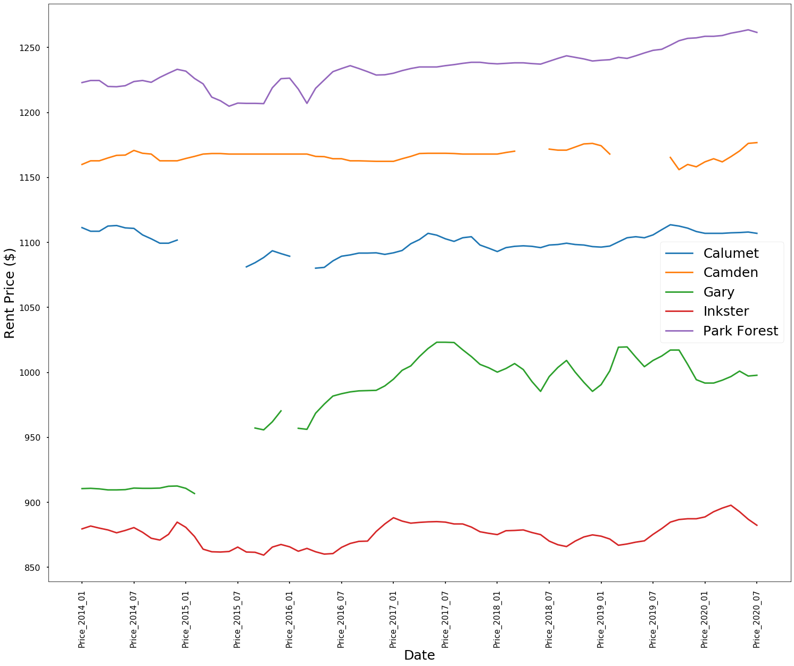
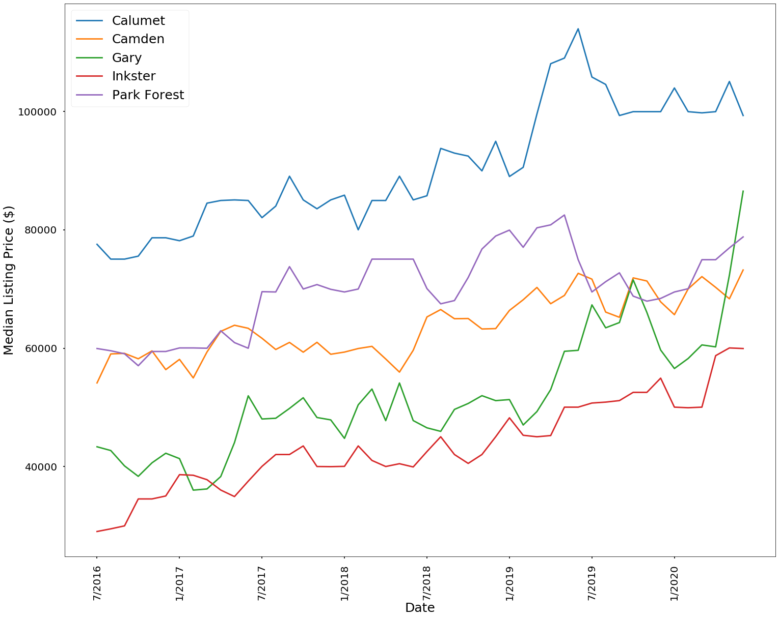
Rent and Listing Price Through Time

Slide 12
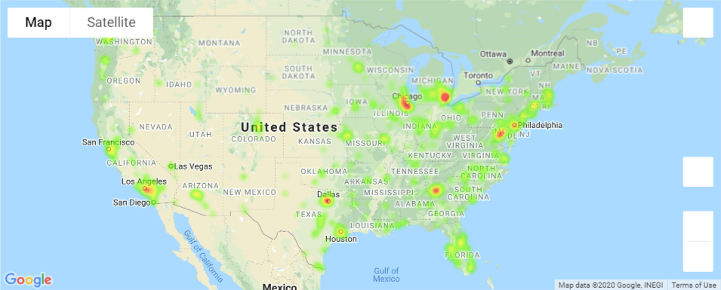
Heat Map of Rent/Listing Price (June 2020)

Slide 13
CONCLUSION
If we had more time, we would consider:
WV has the highest and MT has the lowest rental income percentage compared to home price among 50 states
Top 5 cities with best return
Calumet City, IL
Camden, NJ
Gary, IN
Inkster, MI
Park Forest, IL
Crime rate
Job growth
School quality
Average Income

